Slide 1
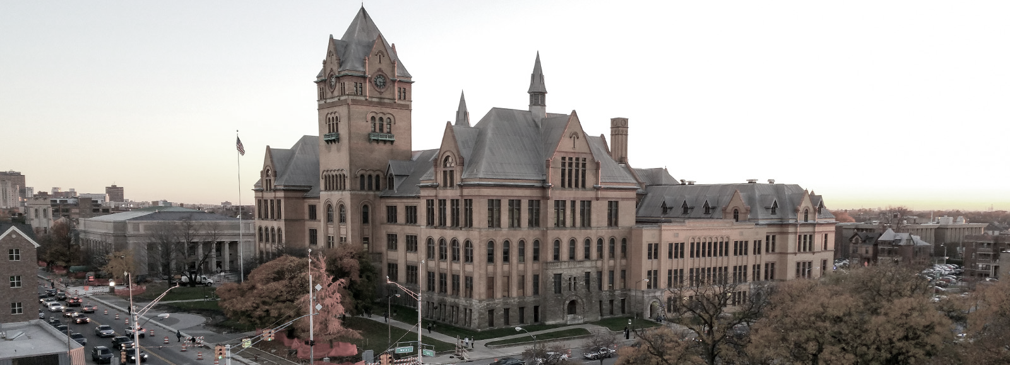
Graduate School Overview

Slide 2
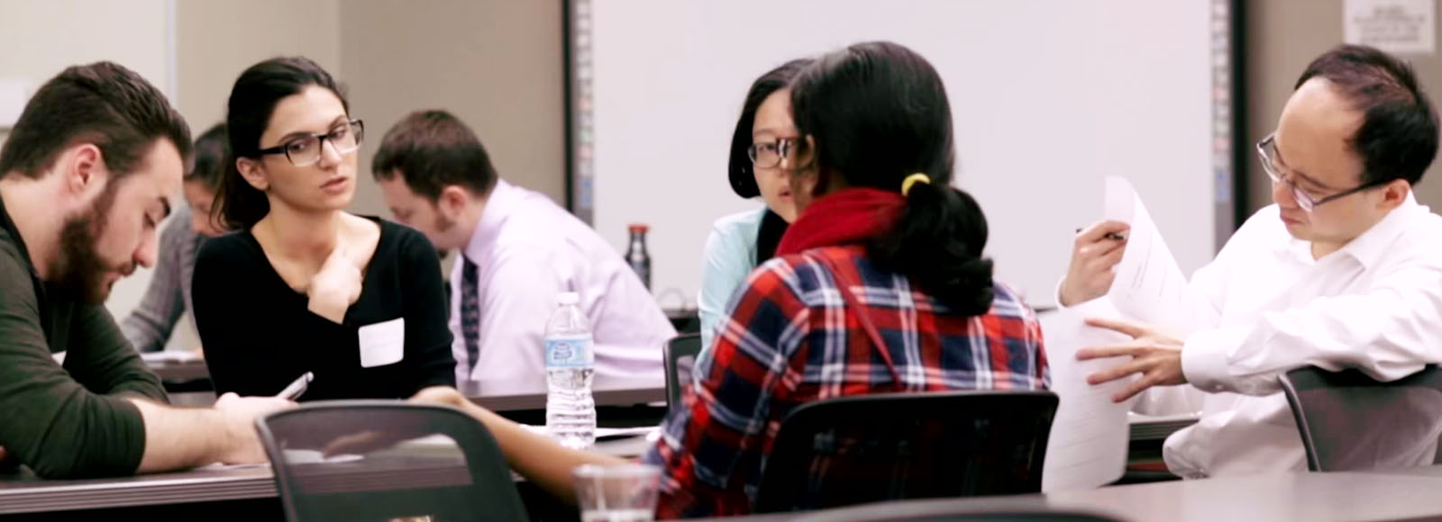
11 Schools and Colleges
240 graduate programs
7,622 students
55 graduate certificates with 300 students
71 doctoral programs with 1,680 students
114 master’s programs with 5,642 students
116 postdoctoral scholars
810 graduate faculty with an appointment via the Graduate School

Slide 3
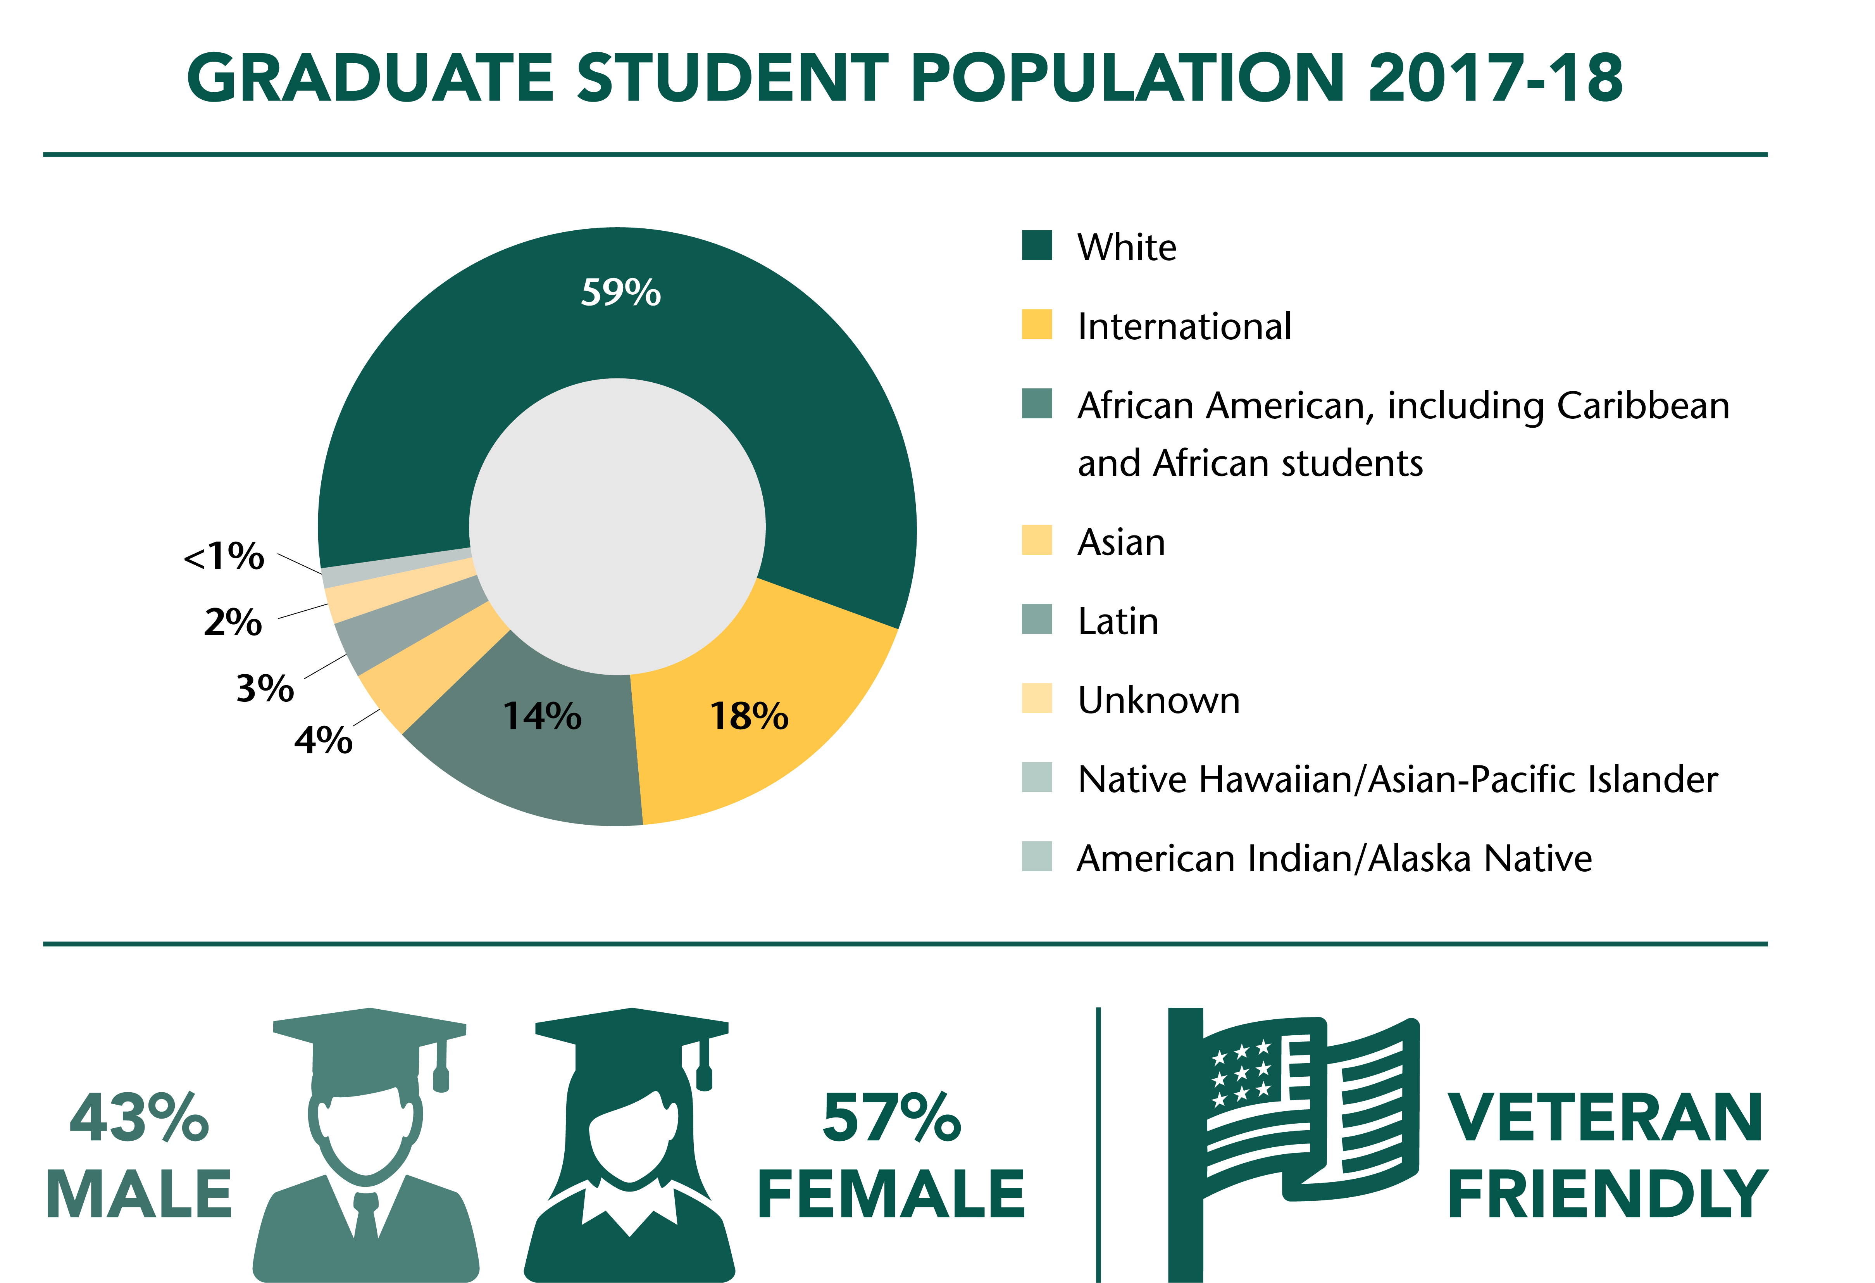
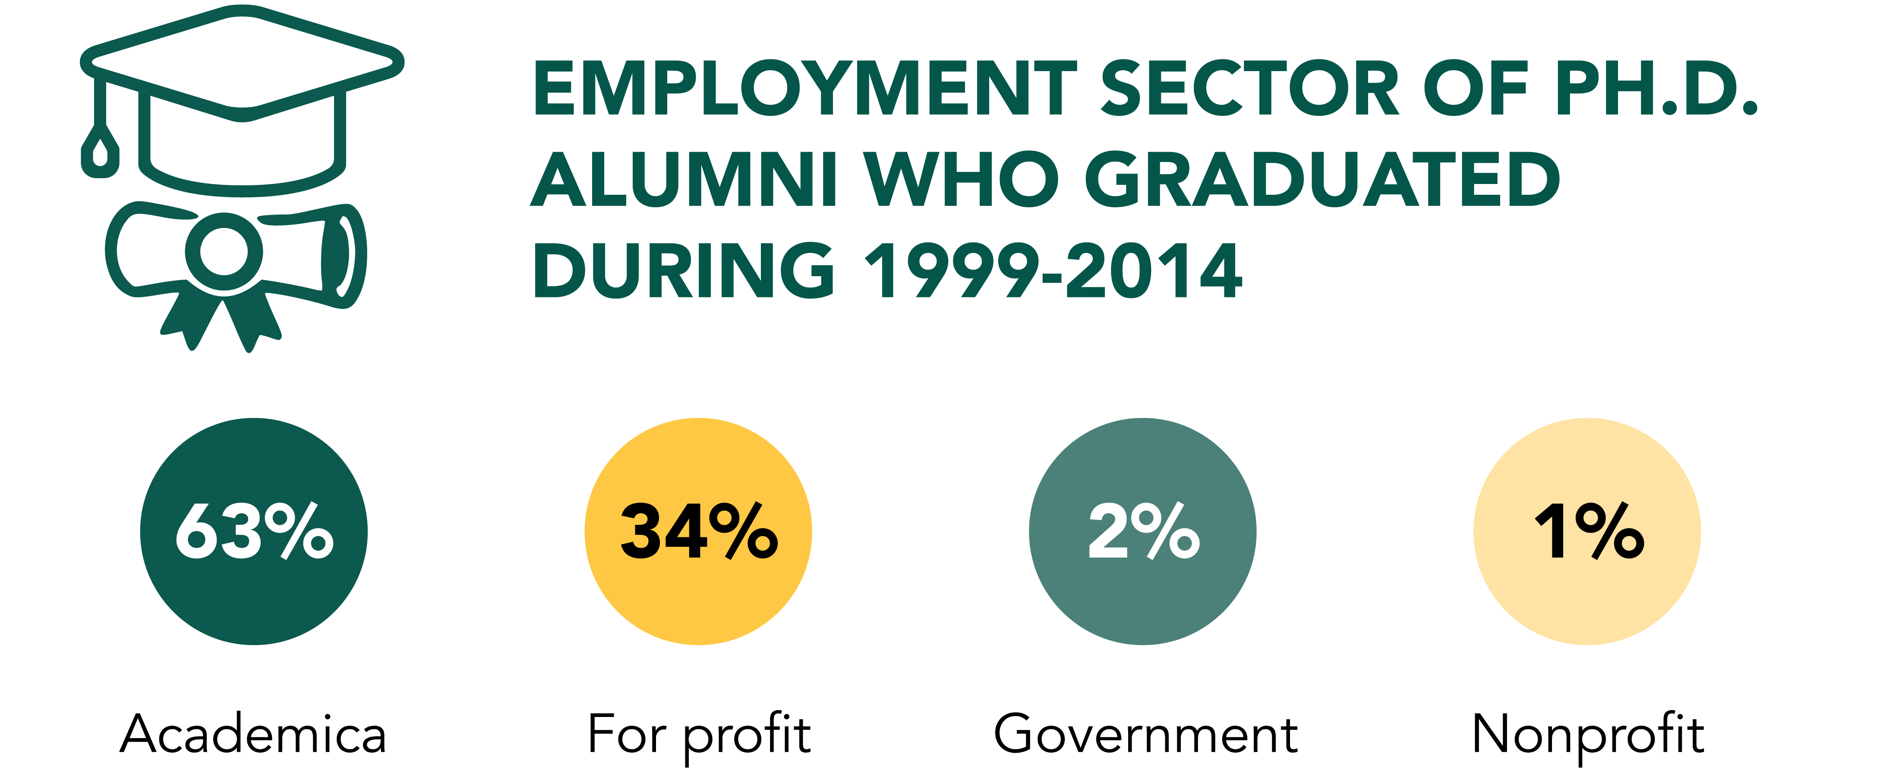
Demographics

Slide 4
$23.5 million in grants
$21.2 million | ReBUILDetroit until Sept. 29, 2019
NIH/NIGMS and NIH Office of Director: Linked Awards
Goal: enrich the depth and diversity of perspectives in biomedical research in urban Detroit
PI Ambika Mathur and Katherine Snyder
$1.8 million | Broadening Experiences in Scientific Training (BEST) until Aug. 31, 2018 but resources will continue
NIH/NIDCR and NIH Office of the Director
Goal: to introduce doctoral trainees in the biosciences to a dynamic and evolving job market and explore diverse career pathways and opportunities
PI Ambika Mathur and Christine Chow
$60,000 | Understanding Ph.D. Career Pathways for Program Improvement until June 30, 2020
Council of Graduate Schools (Subaward from the Andrew Mellon Foundation and the NSF)
Goal: to track outcomes of Ph.D. alumni in the Humanities and STEM fields to understand career pathways and meet the evolving needs of doctoral students.
PI Ambika Mathur
$104,000 | King Chavez Parks (KCP) Future Faculty Fellowship Program, annual recurring
State of Michigan
Goal: to increase the pool of traditionally underrepresented candidates pursuing faculty teaching careers in postsecondary education.
PI Ambika Mathur
$299,826 | NSF includes DDLP: BEST BET: Broadening the Experiences of Scientific Training – Beginning Enhancement Track until Oct. 31, 2019
NSF 1744445
Goal: to engage undergraduate students from populations underrepresented in STEM to explore career opportunities in academia, industry, science communications, policy and law.
PI Linda Hyman, Boston University
Advancing Child Health through Cellular and Molecular Biology until Nov. 30, 2022
NIH/NICHD 2K12HD028820-26
PI Valerie Opipari, University of Michigan

Slide 5
Graduate School Publications & Presentations
Mathur, A. and D. Kamat. 2014. The Value of the Personal Statement. J Pediatrics 164(4):682-683. PMID 24632783.
Mathur, A., F. Meyers, T. O'Brien, R. Chalkley, and C. Fuhrmann. 2015. Transforming training to reflect the workforce. Sci Transl Med 29 April 2015: Vol. 7, Issue 285, p. 285ed4.
F. Meyers, A. Mathur, C. Fuhrmann, T. O'Brien, P. Labosky, D. Duncan, I. Wefes, A. Wart, M. Friedlander, A. Feig, and R. Chalkley. Meyers, F., A. Mathur, C. Fuhrmann, T. O'Brien, I. Wefes, P. Labosky, D. Duncan, A. August, K. Gould, M. Friedlander, C. Schaffer, and A. Van Wart. 2015. The Origin and Implementation of the Broadening Experiences in Scientific Training (BEST) Programs: An NIH Common Fund Initiative. FASEB J doi:10.1096/fj.15-276139.
Feig, A., L. Robinson, S. Yan, M. Byrd, A. Mathur. Using Longitudinal Data on Career Outcomes to Promote Improvements and Diversity in Graduate Education. 2016. Change: The Magazine of Higher Learning 48:6, 42-49.
P. Hitchcock, Mathur,A., J. Bennett, P. Cameron, C. Chow, P. Clifford, R. Duvoisin, A. Feig, K. Finneran, D. Klotz, R. McGee, M. O'Riordan, C. Pfund, C. Pickett, N. Schwartz, N. Street, E. Watkins, J. Wiest, D. Engelke. The future of graduate and postdoctoral training in the biosciences. 2017. eLife. doi: 10.7554/eLife.32715.
Andreoli, J. M.; Feig, A.; Chang, S.; Welch, S.; Mathur, A.; Kuleck, G. A Research-Based Inter-institutional Collaboration to Diversify the Biomedical Workforce: ReBUILDetroit. Biomed. Central Proc. 2017, doi: 10.1186/s12919-017-0093-6.
Mathur, A., A. Cano, M. Kohl, N. Muthunayake, P. Vaidyanathan, M. Wood, and M. Ziyad. 2018. Visualization of gender, race, citizenship and academic performance in association with career outcomes of 15-year biomedical doctoral alumni at a public research university. PLOS ONE. 13(5): e0197473. https://doi.org/10.1371/journal.pone.0197473.
7 more (and counting) publications & 45 presentations on the Graduate School’s new publications page…

Slide 6
Ph.D. Process Overview
The Graduate School oversees the Ph.D. process from admission to completion. Below is a stepwise path to your Ph.D. completion that include:
  Departmental orientation and advising
  Annual Individual Development Plan (IDP) available March 1
  Annual review
  Responsible Conduct for Research
  Plan of Work submission prior to completing 40 credits of coursework
  Qualifying examination/oral examination
  Candidacy and dissertation registration
  Dissertation prospectus and advisory committee
  Dissertation defense
The PhD is expected to be completed within 7 years. Under extenuating circumstances, time exceptions may be granted. Please check the Graduate School website for timelines requesting extensions. https://gradschool.wayne.edu/phd/time-extension
For more information on the Ph.D. process, including requirements, policies and procedures, guidelines and forms for completing a Ph.D. program visit https://gradschool.wayne.edu/phd/process
For Ph.D. forms, visit https://gradschool.wayne.edu/phd/forms.
Ph.D. Office email: phdstudents@wayne.edu

Slide 7

Funding
The Graduate School provides more than $20 million a year in student support to help graduate students fund their education.
Financial support can come in many forms and from various channels–individual departments within the university, merit-based scholarships, fellowships, need-based financial aid and an array of external sources. Be sure to check with your department for specific application information and unique opportunities in your field. Eligibility, enrollment and application requirements vary.
For more information, visit https://gradschool.wayne.edu/funding

Slide 8

Responsible Conduct for Research
Training in Responsible Conduct of Research (RCR) practices is a MANDATORY requirement for all first year PhD students.
PhD students must enroll in the RCR training course, GS 0900 titled, "Essential Research Practices: Responsible Conduct of Research" in either the Fall or Winter terms (Check with your Graduate Officer to see which term is best for you)
All PhD scholars are required to attend a day-long Saturday workshop during the term they register for course*
  Fall 2018 term – Workshop is on Saturday, September 29th
  Winter 2019 term – Workshop is on Saturday, January 26th
  * Alternative workshop scheduled for students who cannot attend due to Religious Conflicts with attending a Saturday Workshop
There is an online course required before you can take the Saturday Workshop.
More information is available at https://gradschool.wayne.edu/postdoc/research-conduct

Slide 9
Individual Development Plan
Individual Development Plans (IDPs) are documents designed to support doctoral students and postdoctoral trainees in their professional development. The IDP provides a structure to identify concrete steps towards long-term goals and a framework for constructive conversation between students and their mentors/advisors.
An annual IDP is a MANDATORY requirement for ALL doctoral students and postdoctoral trainees regardless of funding status.
IDP’s must be submitted by the end of the first year and updated annually.
The deadline for PhD students is May 15th of each year.
For more information on how to complete your IDP, visit https://gradschool.wayne.edu/phd/idp

Slide 10
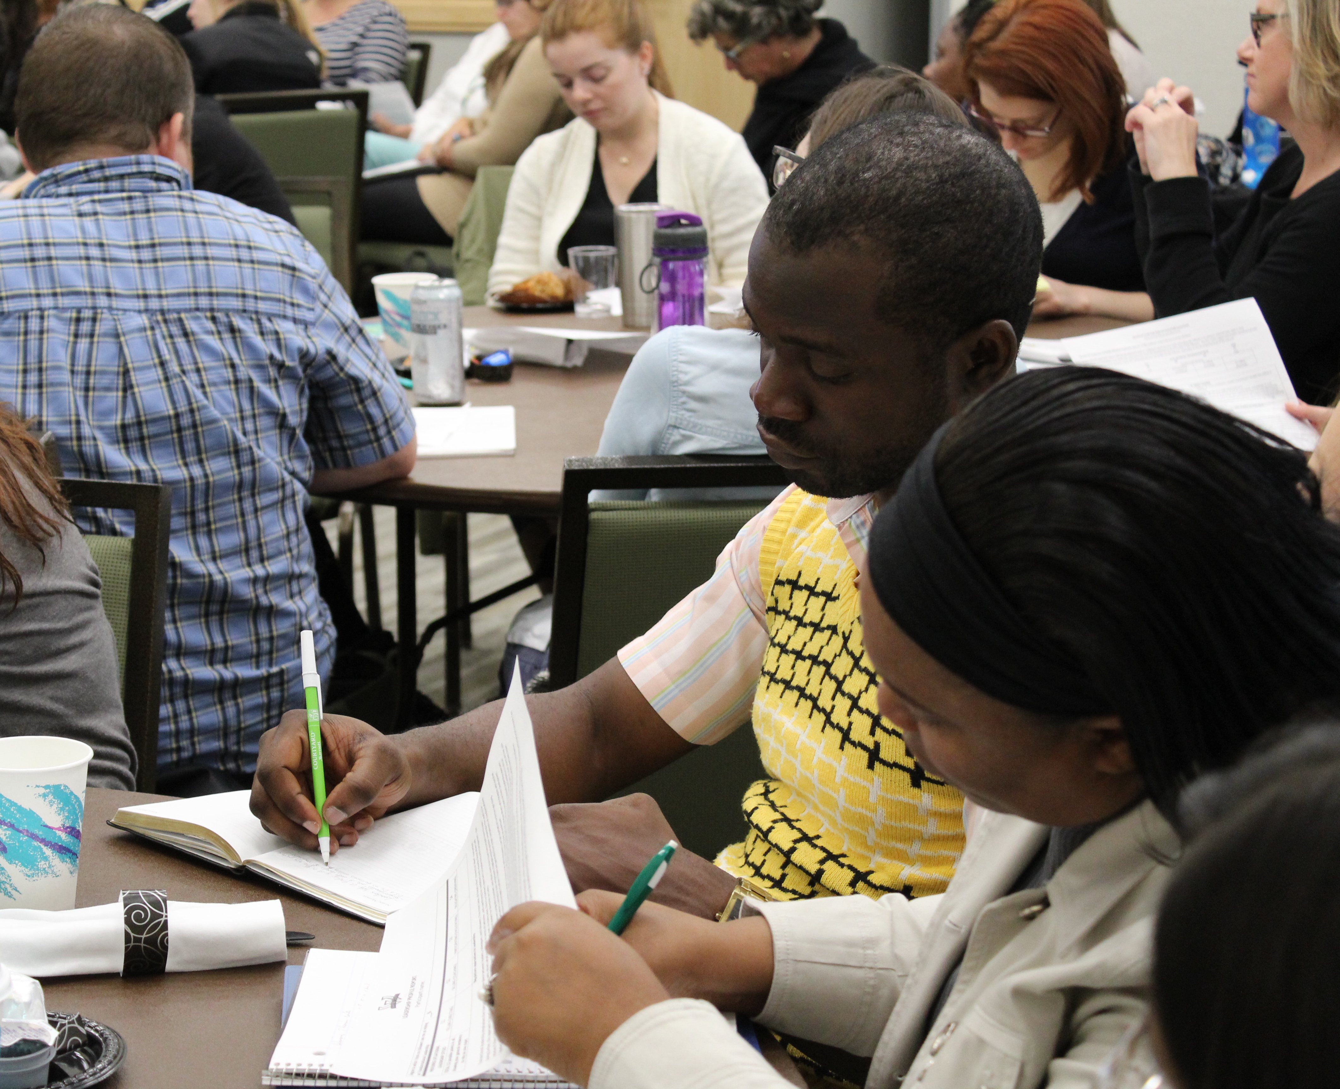
Graduate and Postdoctoral Professional Development Series
The Graduate School promotes exploration in a variety of careers and provides a range of professional development opportunities for graduate students and postdoctoral scholars as they prepare for these careers and goals.
Our Graduate and Postdoctoral Professional Development (GPPD) seminar series covers a range of topics that are of interest to trainees including abstract writing, job search skills, poster presentation skills, and career opportunities. This annual series is organized by nationally recognized core competencies.
136% increase in GPPD seminar attendance between 2016-17 and 2017-18
For more information, visit: https://gradschool.wayne.edu/professional-development

Slide 11





Micro-Credentialing Program
The Graduate School has identified five core competency areas that are critical to successful degree completion, scholarly and creative contributions and leadership roles across diverse career paths:
A micro-credential, also called a digital badge, is a tool for showcasing the skills and experience that may not be readily apparent by reading an academic transcript, resume or CV. These badges are shareable via social media and professional websites.
Micro-credentials in each of the areas above are issued to graduate students and postdoctoral scholars who participate in various professional development seminars, workshops and activities, and demonstrate mastery of skills within each category as evaluated by expert faculty and facilitators. For more information visit https://gradschool.wayne.edu/professional-development/micro-credentials
70% increase in micro-credentials awarded between 2016-17 and 2017-18

